Slide 1
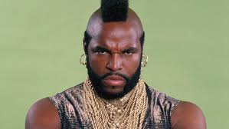
Verbals
Don’t be
Fooled!
Verbals - FAKE verbs
words that look like verbs, BUT act like a noun, adjective, or adverb.
Three types of verbals:
Gerunds, Participles, & Infinitives

Slide 2
Verb vs. Verbal
Verb
Verbal
-Performs as a noun, adjective, or adverb
The girls love dancing in the rain.
They hate skiing.
-Performs an action in a sentence
The girls are dancing in the rain.
They are skiing today.
End in –ing, - en, & -ed
Dancing
Skiing

Slide 3
Types of Verbals
 | Gerund | Participle | Infinitive
Identifying Hint | -ing | -ed, -en, or –ing | to + Verb Word
Use | Noun *You can replace the gerund phrase with “this” or “something” and it will make sense. | Adjective | noun, adjective, adverb
Example | The tourists love skiing at our resort. | The skiing tourists love our resort. | The tourists love to ski at our resort.

Slide 4
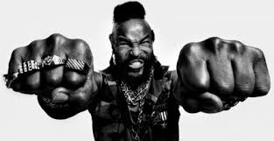
Verb or Verbal?
Identify the underlined word in each sentence as a “Verb” or “Verbal.”
Finding treasure is a unique experience.
My biggest goal is finding a cave full of treasure.
Pirates buried treasure in the caves on Eleuthera.
Unfortunately, the buried treasure was never found on Eleuthera.
However, pirates are known for burying treasure in the Bahamas.
I pity the fool
who don’t know the
difference.

Slide 5
Finding treasure is a unique experience.
My biggest goal is finding a cave full of treasure.
Pirates buried treasure in the caves on Eleuthera.
Unfortunately, the buried treasure was never found on Eleuthera.
However, pirates are known for burying treasure in the Bahamas.
Verbal
Verbal
Verb
Verbal
Verbal

Slide 6
Practice: Which Verbal?
Identify which type of verbal phrase is being used by labeling as “gerund,” “participle,” or “infinitive.”
Finding treasure is a unique experience.
My biggest goal is finding a cave full of treasure.
Unfortunately, the buried treasure was never found on Eleuthera.
However, pirates are known for burying treasure in the Bahamas.

Slide 7
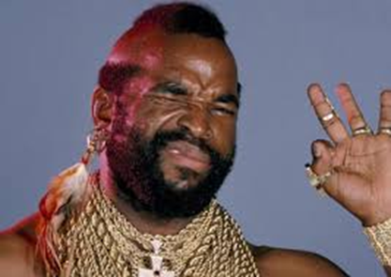
Check It!
Finding treasure is a unique experience.
My biggest goal is finding a cave full of treasure.
Unfortunately, the buried treasure was never found on Eleuthera.
However, pirates are known for burying treasure in the Bahamas.
Gerund
Gerund
Participle
Gerund

Slide 8
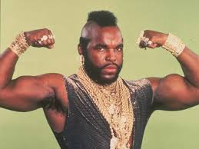
Practice: Infinitive or Preposition?
The best time to visit Florida is December through April.
We usually travel to Florida around New Year’s Eve.
Trista went to Daytona to celebrate her birthday.
The tourists were ready to check into their rooms.
The tourists asked the tour guide to take them around the best beaches.
Perfect practice
makes perfect fool.

Slide 9
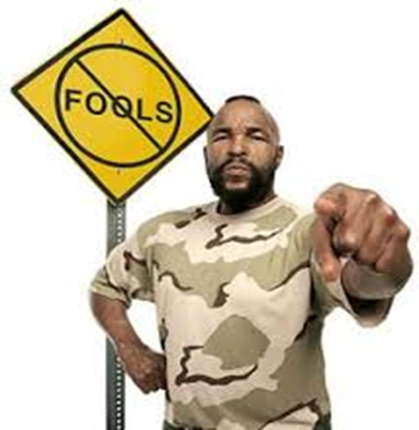
Check It!
Infinitive
Preposition
Preposition; infinitive
Infinitive
Infinitive
The best time to visit Florida is December through April.
We usually travel to Florida around New Year’s Eve.
Trista went to Daytona to celebrate her birthday.
The tourists were ready to check into their rooms.
The tourists asked the tour guide to take them around the best beaches.

